Slide 1
Business Objectives
HIGH VOLUMES
HIGH VALUE
AFFORDABLE | EVERYDAY VALUE | PREMIUM QUALITY | HIGH END LUXURY | META LUXURY

Slide 2
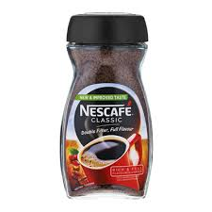
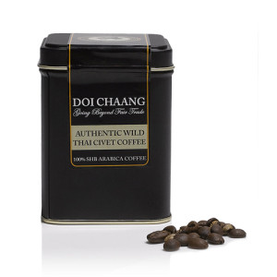
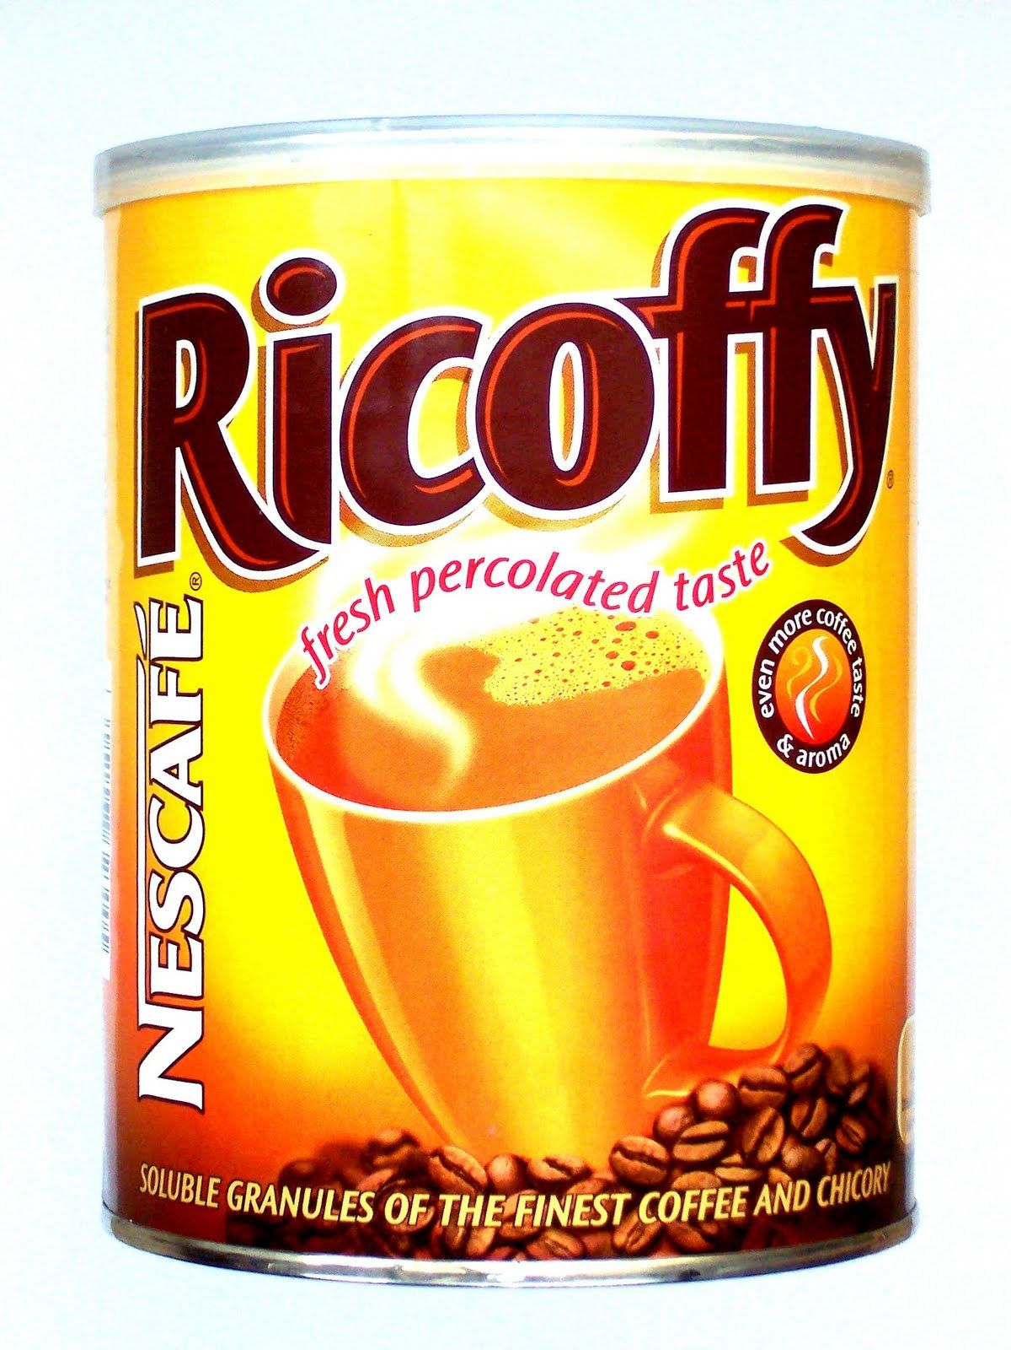
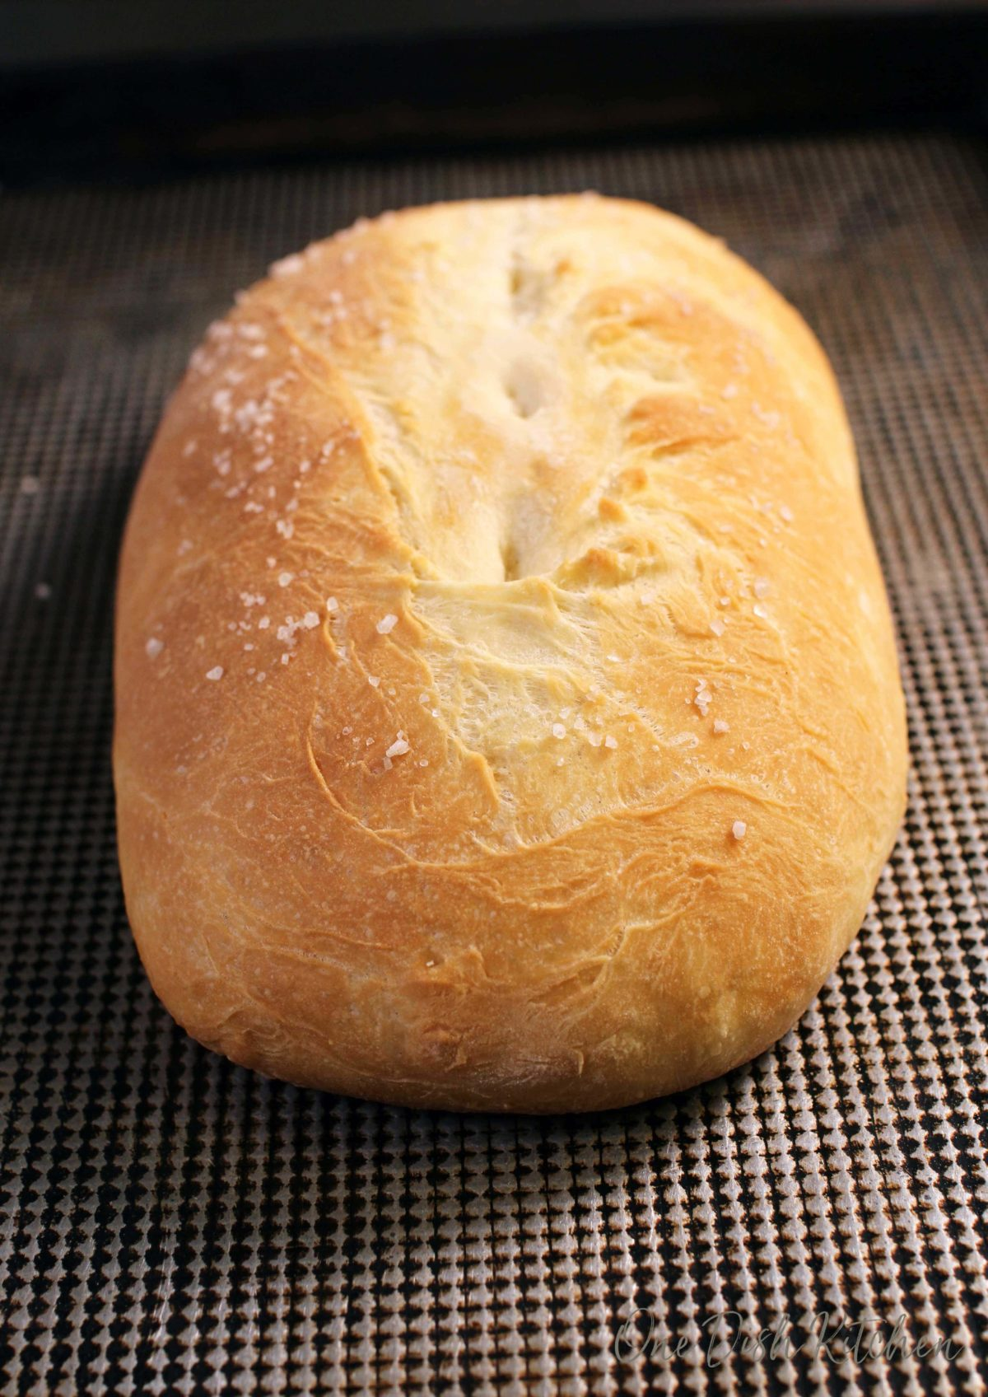
AFFORDABLE | EVERYDAY VALUE | PREMIUM QUALITY | HIGH END LUXURY | META LUXURY

Slide 3
The type of experience we need to create:
AFFORDABLE | EVERYDAY VALUE | PREMIUM QUALITY | HIGH END LUXURY | META LUXURY
For everyone
Lowest price
Everyday savings
For everyone
Trusted
Everyday enjoyment
For achievers
High value
Best quality
For select few
Carefully crafted
Refined taste
Elite
Masters of craft
Uber lifestyle
BRAND
Huge discounts
Bulk buying
Coupons
Discounts
Buy 1 get 1 free
Reusable packaging
Complimentary
vouchers
Experiences
Stories
Experiences
Stories
Experiences
Stories
RETAIL
Mass Wholesale
Highest reach channels
Biggest retail chains
Loyalty programs
Big financial institutes
Retail chains
Other premium
and luxury brands
Specific environments
Niche environments
Direct mostly
PARTNERS

Slide 4
Identify our strongest entry point into our story
Who organisation
Who consumer
Where and When

